Slide 1
Digital Signing or e-Signing of Document

Slide 2
Are you integrating your solutions to a platform fordocument signing?
Notes:
Flyttas till intro-bilden…

Slide 3
Johan Hedman SquareMoon Sweden Certified Developer Frequent Speaker
Notes:
Flyttas till intro-bilden…

Slide 4
Agenda
What is
Compare
Example

Slide 5
What is the different types for signatures

Slide 6
Electronic signature

Slide 7
Biometric signature

Slide 8
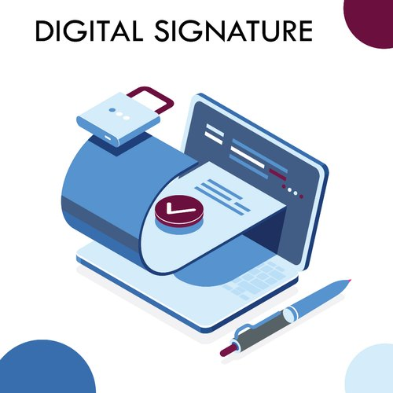
Digital signature

Slide 9
Advanced Biometric signature using Digital Signature

Slide 10
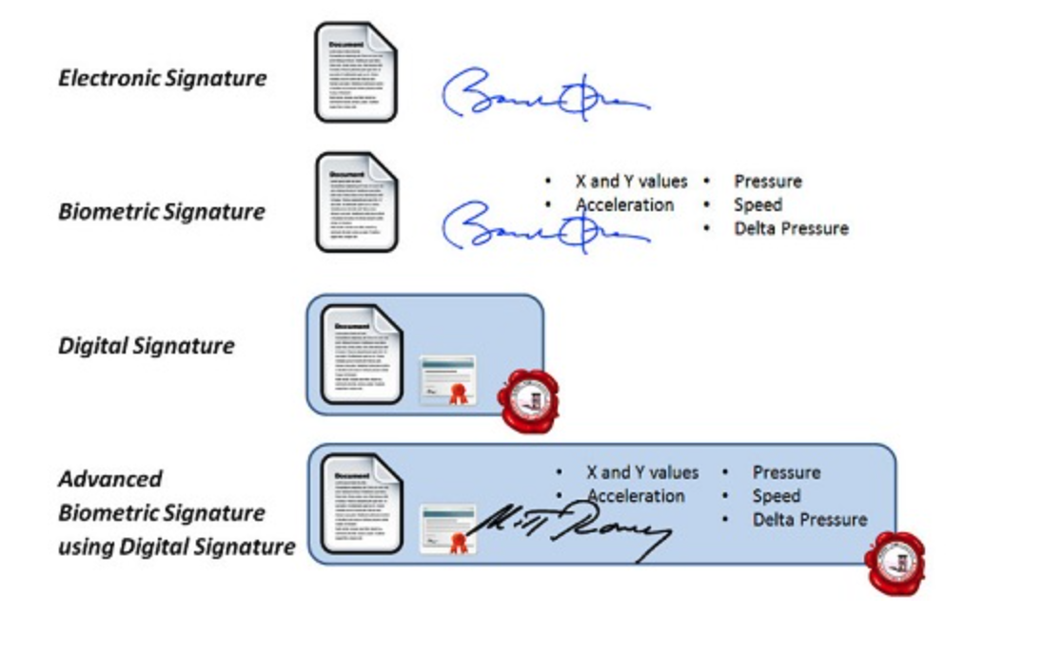

Slide 11
Key features of Digital Signature

Slide 14
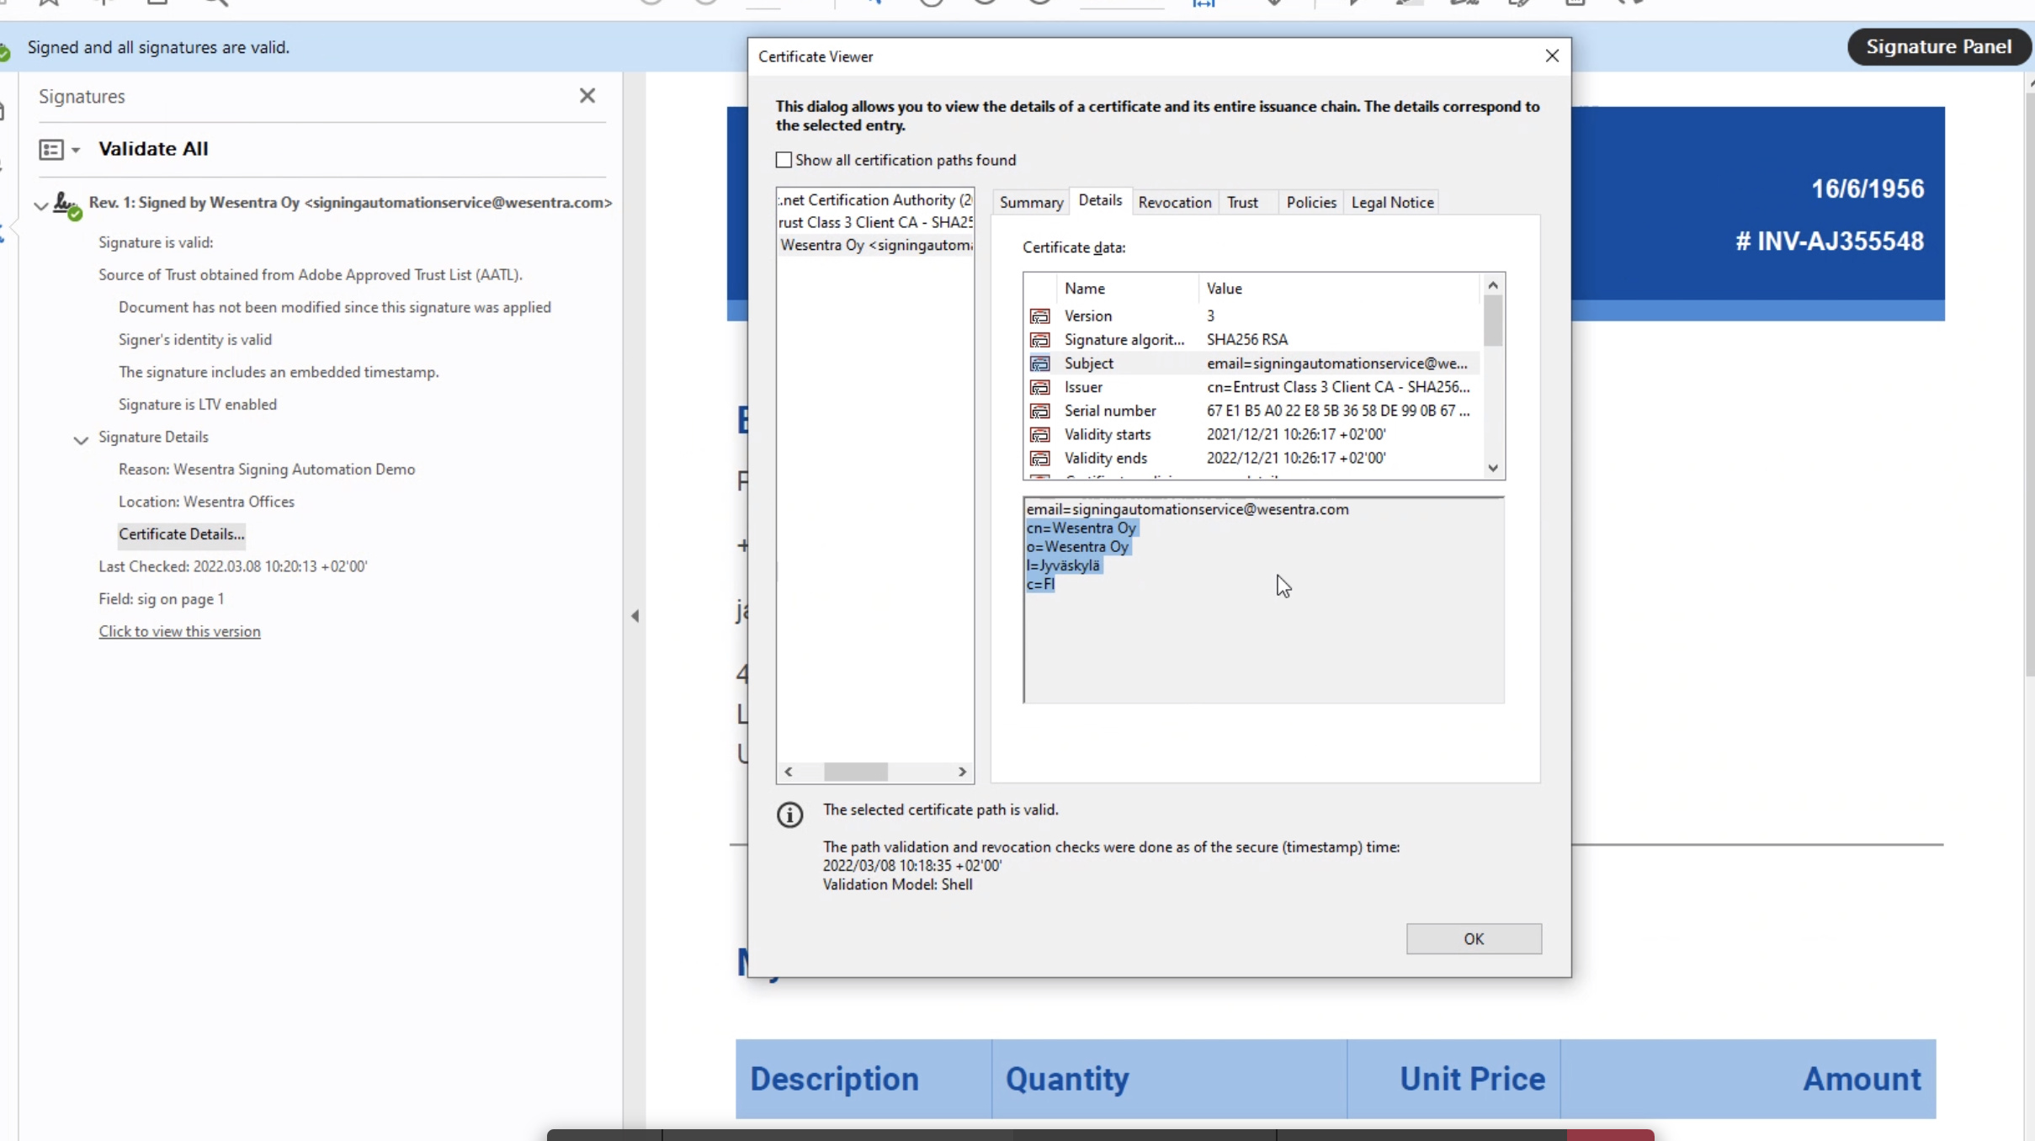

Slide 15
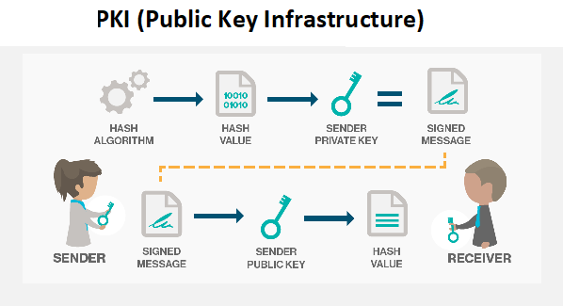
E-seal + Timestamp

Slide 16
Scrive
Entrust
Digicert

Slide 17
Scrive
Demo

Slide 18
Prove the authenticity of the document and its source
Make sure that the document has not been tempered with
Personal identity has been verified

Slide 19
Key features of Electronic Signature

Slide 20
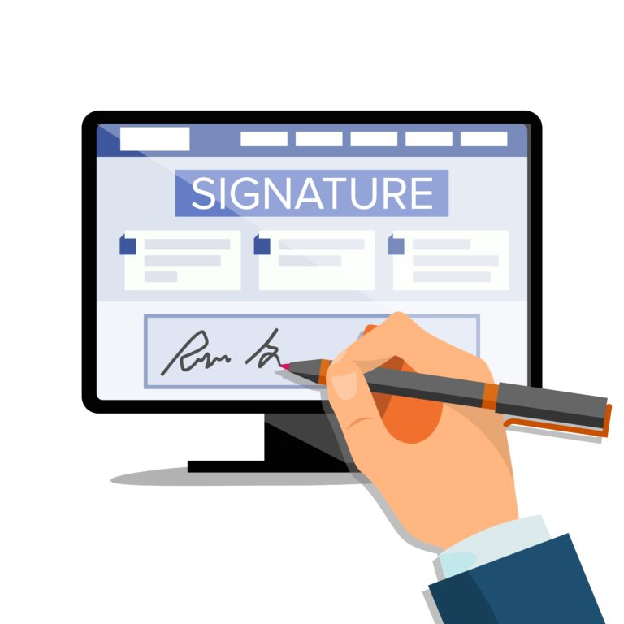

Slide 21
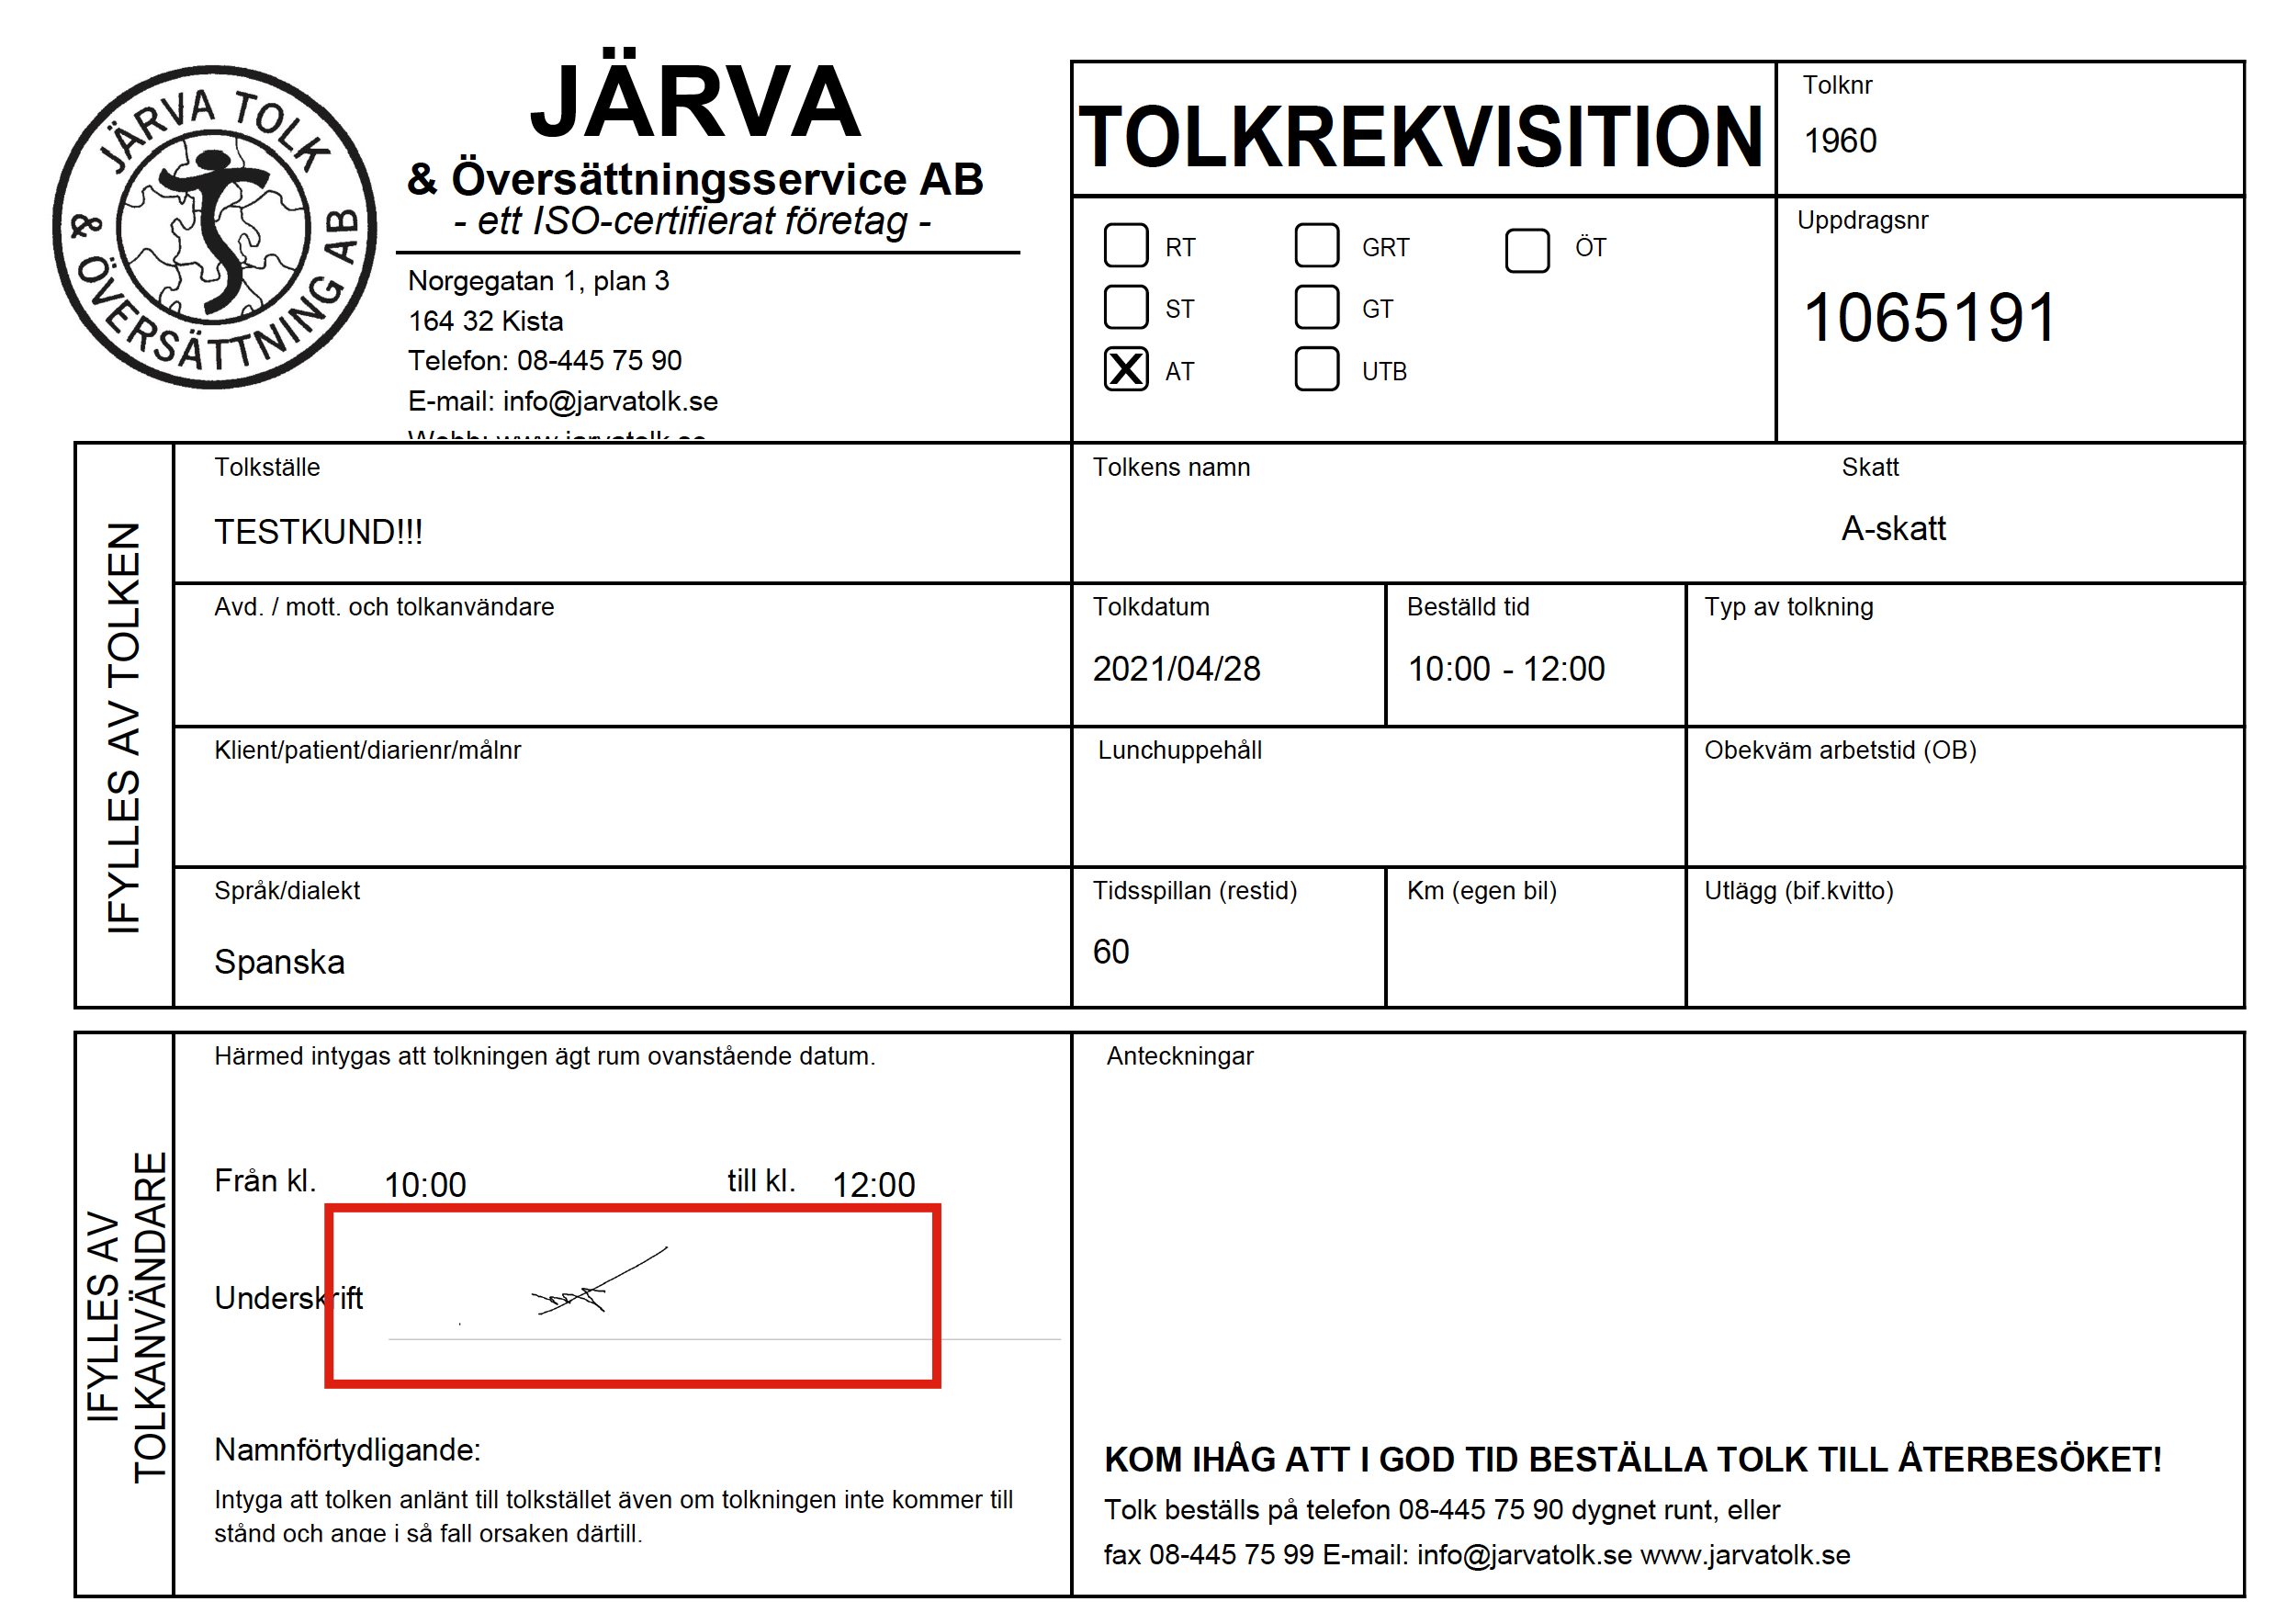

Slide 22
Reveal intent by the signer to sign the document
Could be signed by two parties
Personal identity has been verified, but can be hard to verify

Slide 23
Differences
Digital Signing
E-Signing
Used to secure document
A digital signature is authorized and regulated by certification authorities
Comprised of more security features
A digital signature can be verified
Preffered more than electronic signature due to high levels of authenticity
Particylary concerned about securint the document
Main used to verify document
Usuallt not authorized
Comprised of less security features
Main types of electronix signature include verbal, electronic tiks or scanned signatures
An electornic signature cannot be verified
Easy to use but less authentic
Shows intent to sign the contract

Slide 24
Do you have clients asking for signing of document?

Slide 25
E-seal + Timestamp
https://www.youtube.com/watch?v=ARADZsGThUw

Slide 26
E-signature
https://www.youtube.com/watch?v=vlumAWIErrs

